Slide 1
Development Theories

Slide 2
Sigmund Freud
Oral (0-18 months) | Pleasure is derived from mouth
Anal (18 months-3 years) | Pleasure holding or releasing feces
Phallic (3-6 years) | Boy is in love with his mother & girl is in love with her father
Latency (6-Adolescence) | Focus on social relationships
Genital (Adolescence to Adulthood) | Dating, love, marriage, creating a family

Slide 3
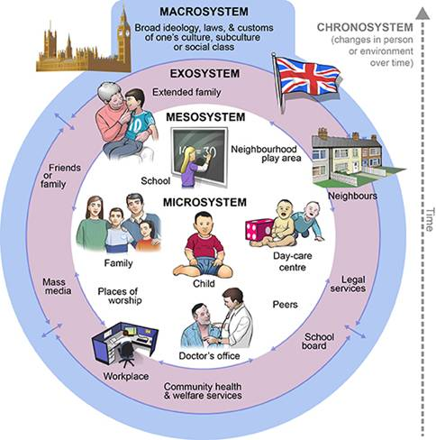
Bronfenbrenner

Slide 4
Erik Erikson
1- Infancy: Trust vs. Mistrust | 5- Adolescence: Identity vs. Confusion
2- Early Childhood: Autonomy vs. Shame | 6- Early Adulthood: Intimacy vs. Isolation
3- Play Age: Initiative vs. Guilt | 7- Adulthood: Generativity vs. Stagnation
4- School Age: Industry vs. Inferiority | 8- old Age: Integrity vs. Despair

Slide 5
Jean Piaget
Birth – 2 year | Sensorimotor: experiencing the world through senses and actions
2 – 6 years | Preoperational: representing things with words and images
7 – 11 years | Concrete Operational: thinking logically about concrete events and grasping concrete analogies
12 - Adulthood | Formal Operational: thinking about hypothetical scenarios and processing abstract thoughts

Slide 6
Lev Vygotsky
Children construct their knowledge Development can not be separated from its social context Learning can lead development Language plays a central role in mental development

