Slide 1
Nutritional Needs During Adolescence

Slide 2
Adolescence & Puberty
Puberty: the period of time when children rapidly change biologically, psychologically, socially and cognitively
Girls: 9-14
Boys: 10-17
Adolescence: transition period between childhood and adulthood
Second period of rapid growth next to the first year after birth

Slide 3
Why do teenagers have higher nutrient needs?
The dramatic increase in physical growth and development puts greater pressure on the need for nutrients

Slide 4
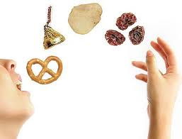
Increase Nutrient Needs
Calories: to provide energy for growth and activity
Boys ages 11-14 need 2,500-2,800 calories each day
Girls need 2,200 each day
Calories should come from lean protein sources, low-fat dairy products, whole grains, fruits and vegetables

Slide 5
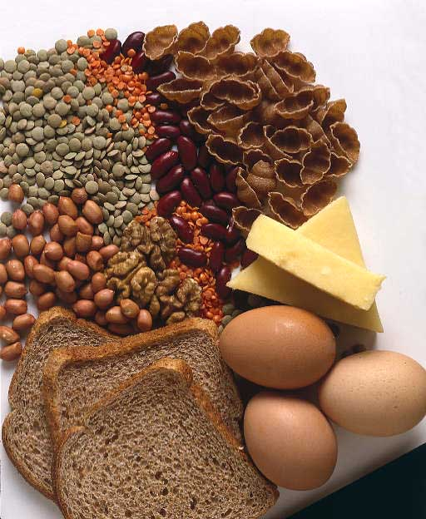
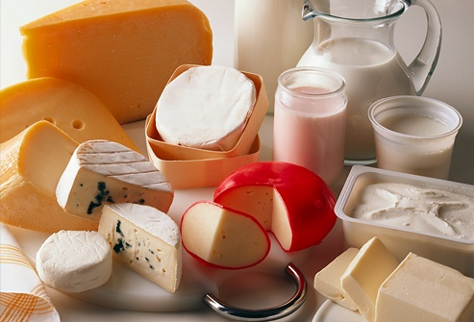
Increase Nutrient Needs
Calcium: essential for development of strong and dense bones during puberty
Inadequate intake during adolescence puts people at risk of developing osteoporosis later in life
Teens are encouraged to consume 3-4 servings of calcium rich foods each day
Good sources include milk, yogurt, cheese, calcium fortified juice and calcium fortified cereals
Protein: for growth and maintenance of muscle
Adolescents need between 45-60 g each day

Slide 6
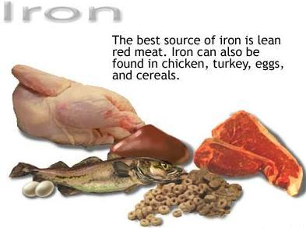
Increased Nutrient Needs
Iron: needed to help new muscle cells obtain oxygen for energy
Inadequate iron intake can lead to anemia
Good sources include beef, chicken, pork, legumes (beans and peanuts), enriched or whole grains and leafy green vegetables such as spinach, collards and kale

Slide 7
Eating Disorders
An attempt to control, avoid and forget emotional pain and distress.
Average onset is 9-12 years of age
Approximately 10 million Americans are suffering with eating disorders
Bulimia is common in men and college students
Anorexia is associated with OCD

Slide 8
Binge Eating
Eating
much more rapidly than normal
until feeling uncomfortably full
large amounts of food when not feeling physically hungry
alone
Feeling disgusted with self, depressed or very guilty after binge
Most common ED
Person turns to food to replace feelings of loneliness/sadness
Food becomes best friend
3,000-5,000 calories in one binge

Slide 9
Anorexia
Intense fear of gaining weight or becoming fat
Disturbance in the way in which one’s body weight or shape is experienced, or denial of the seriousness of the current low body weight
Refusal to maintain body weight at or above minimally normal weight for age and height, lose between 25-50% of body weight
Amenorrhea: the lost of period for at least 3 months or more; become more childlike and feel in control

Slide 10
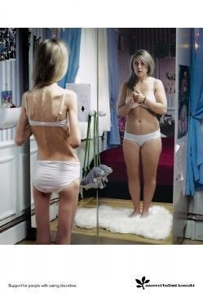
Anorexia Statistics
Only 30-40% fully recover
5-10% die within years
20% will be dead after 20 years

Slide 11
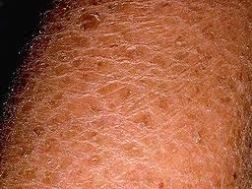
Physical Symptoms
Lower body temperature
Decreased metabolic rate: decreased heart rate
Skin: rough, scaly, dry and cold
Growth of hair on abnormal parts of body
Decreased white blood cells lead to infections
Decreased potassium lead to heart arrhythmia

Slide 12
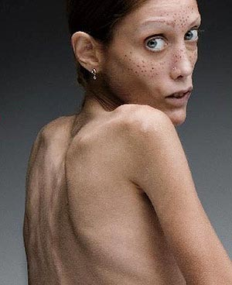
Isabelle Caro
Hannah Crawford, College Sophomore

Slide 13
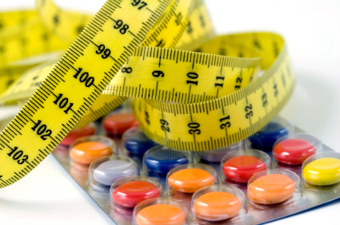
Bulimia
Measures food then measures excrements
Recurrent episode of binge eating followed by self-induced vomiting, misuse of laxatives, diuretics, fasting or excessive exercise

Slide 14
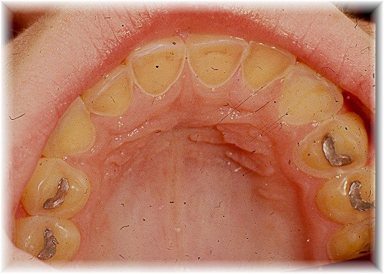
Physical Symptoms
Tooth erosion
Tears of the esophagus or stomach
Infections of the throat, esophagus and salivary glands
Constipation
Electrolyte imbalance leads to heart arrhythmia

